Slide 1
TIME SERIES MODELING SELECTED SUBJECTS
21st February, 2018
Meir TOLEDANO
meir@anodot.com

Slide 2
EXCERICE SETUP

Slide 3

EXERCICE SETUP
https://github.com/sciencefan/itc_workshop
Clone the repository
Setup your environment (follow instructions in setup.txt)
Open the *.Rproj file

Slide 4
THE PROBLEM WE ARE SOLVING

Slide 5
ORDERING A RIDE IN THE RAIN?
Notes:
Describe scenario: orders made, taken, rides, anomaly… rain event.

Slide 6
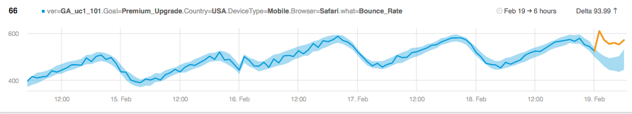
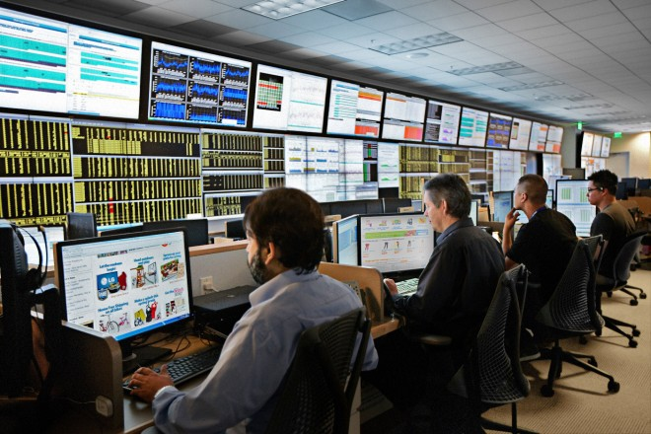
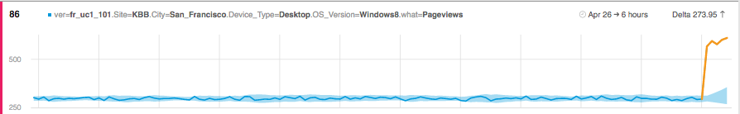
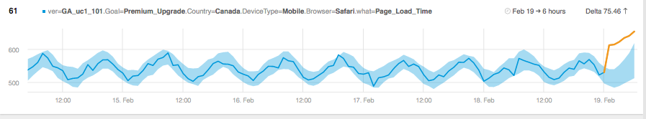
HOW DOES THIS LOOK FROM THE RIDE APP SIDE?
Driver Utilization ⬆
Wait time ⬆
System Utilization ⬆

Slide 7
CONSEQUENCE OF ANOMALIES IN THE REAL WORLD
The business cost of real incident in real world can be up to 100K per incident !!!
It can affect several part of the buisness

Slide 8

















SELECTED CUSTOMERS
“
It used to take us up to several days to identify an issue on a specific page, offer, or service that was draining our revenues. Anodot identifies when a metric increases or decreases in real time, so we can resolve it quickly, before business suffers or revenue is lost.
“
Pedro Silva, Senior product manager, Credit Karma
Notes:
Add DT, GoEuro

Slide 9
THE DATA SCIENTIST POINT OF VIEW

Slide 10
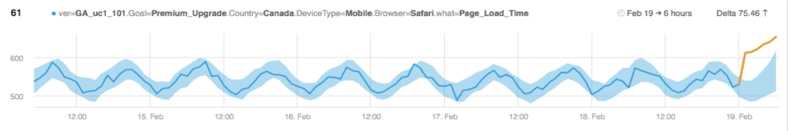
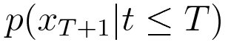
REAL TIME ANOMALY DETECTION STRATEGY
Prediction range
Anomaly = Too far from the expected behavior
Real – time anomaly detection problem (Business problem) =
Conditional prediction problem (Maths/Algo problem)
Conditional prediction problem
Time series modeling (learning)
Real time prediction calculation (inference)
We need to model time series in order to forecast

Slide 11
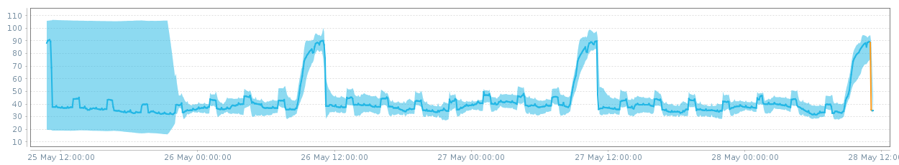
SEASON IN A KEY COMPONENT
The system find the daily pattern (and not the 3h sub-pattern)
The conditional prediction begins then to be very accurate.
We are now able to catch even the smallest anomaly.
We need to find the period of the series

Slide 12
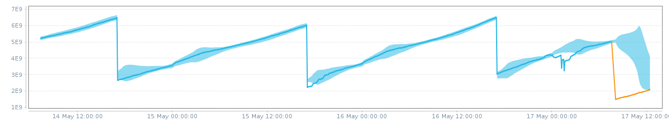
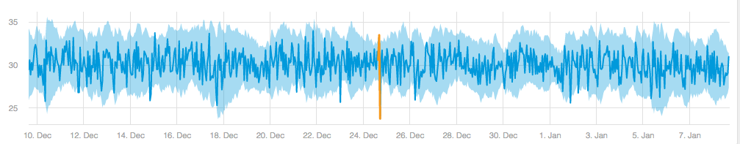
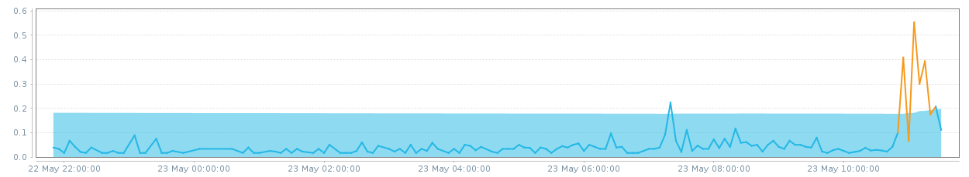
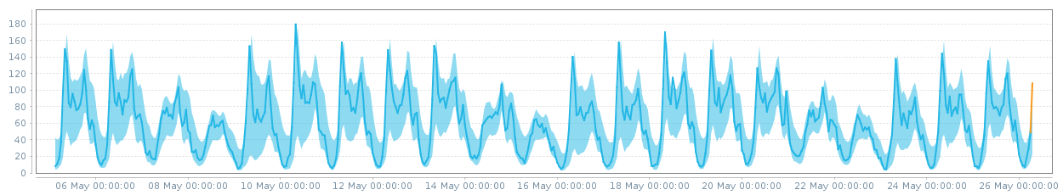
Which kind of TIME SERIES? Which applications ?
Web Services
Industrial IoT
Security
We need a universal time series modeler
Business

Slide 13


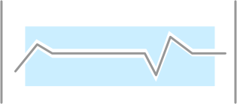



ANODOT IN NUMBERs
5.8 BILLION
120 MILLION
240 MILLION
DATA POINTS PER DAY
UNIQUE METRICS
MODELS
500 MILLION
14 MILLION
30 TYPES
CORRELATIONS
We need to be very fast and very robust
Seasonal Metrics
OF LEARNING ALGORITHMS

Slide 14
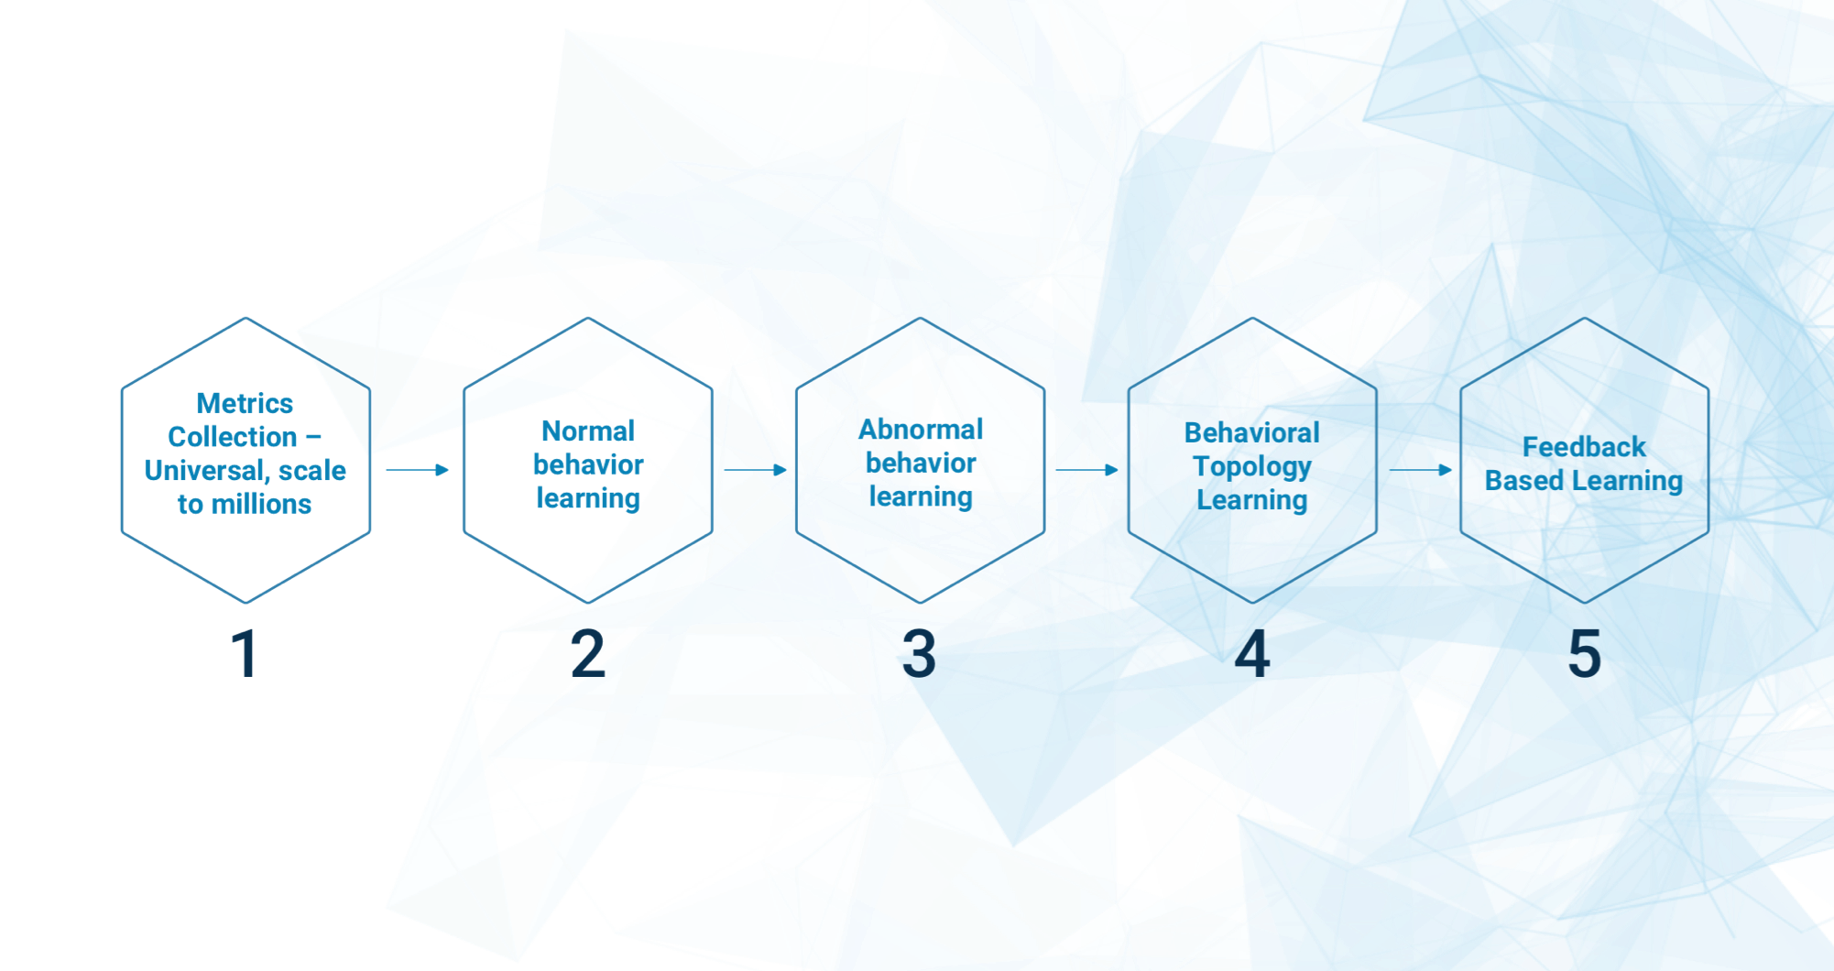
ANOMALY DETECTION PIPELINE
That’s not all folks!
The purpose of the talk

Slide 15
SEASON DETECTION

Slide 16
THE PROBLEM
We have a time series, a ordered list of pair (timestamp, value)
We need to determine if there is a periodic pattern and if so, what is period

Slide 17
EXERCISE
Any ideas how to solve this problem ?
Open Rstudio, read the datas, plot the time series. Which one(s) is periodic which one is not (visual inspection only) ?
Compute the spectrum for SinusNoise. What is the season ? Which algorithm can be derived from this strategy ?
Compute the spectrum for DailyHumanNoise, WeeklyHumanNoise. Do you think the previous algorithm will work ? Analyze the problem
Compute the spectrum for the Spikes *. Do you think the previous algorithm will work ? Analyze the problem
What can we do ?
Compute the ACF for SinusNoise ? Which algorithm can be derived from this strategy ?
Will it work for others time series ?

Slide 18
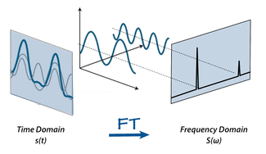
Discrete Fourier transform – The idea
Algorithm outline:
Compute the power spectrum of the time series
Find local maximums
Filter relevant maximum

Slide 19
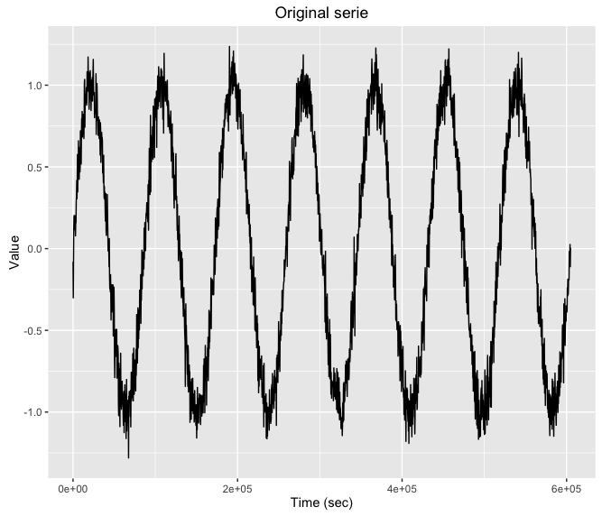
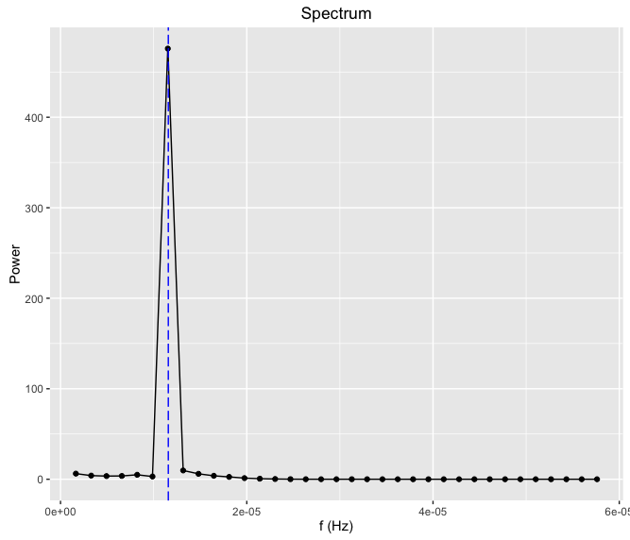
Discrete Fourier transform – Example

Slide 20
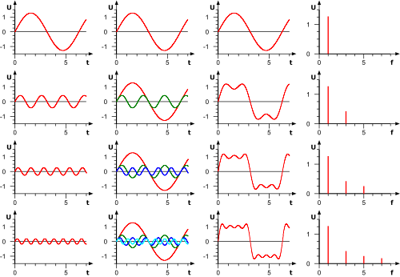
Discrete Fourier transform – HARMONIC

Slide 21
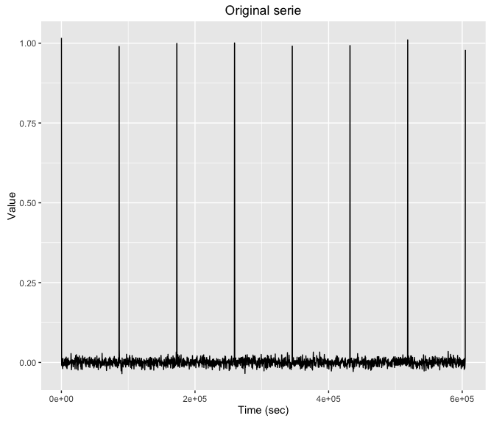
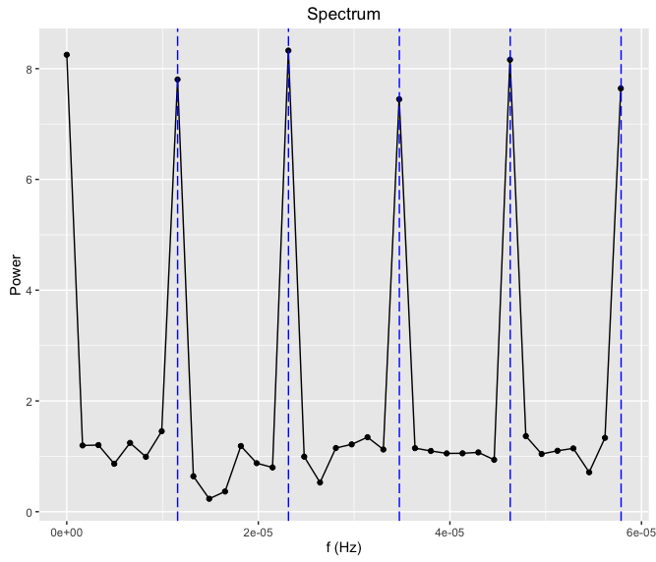
Discrete Fourier transform – Harmonic problem

Slide 22
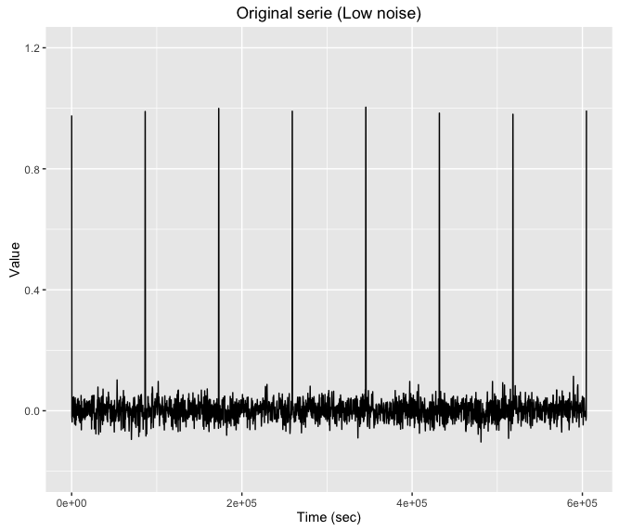
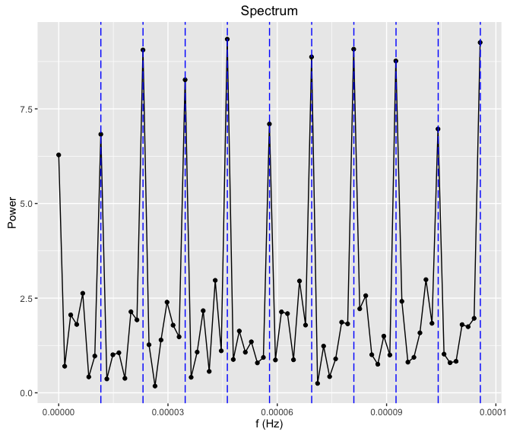
Discrete Fourier transform – Impact of noise

Slide 23
Discrete Fourier transform – Impact of noise
The Fourier transform is linear which means
So the spectrum is “contaminated” by the FFT of the noise and anomalies. Thus if the series is noisy or with lots of anomalies, the spectrum will be noisy.

Slide 24
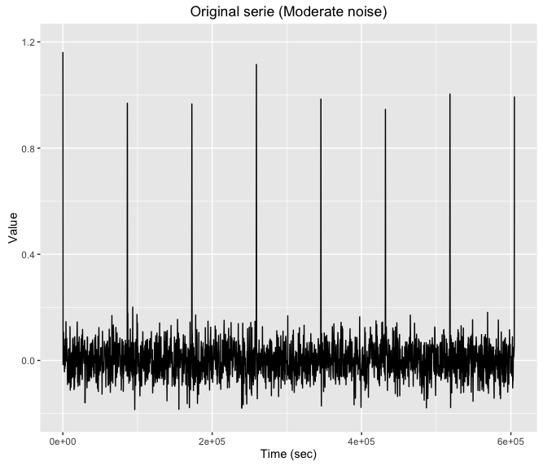
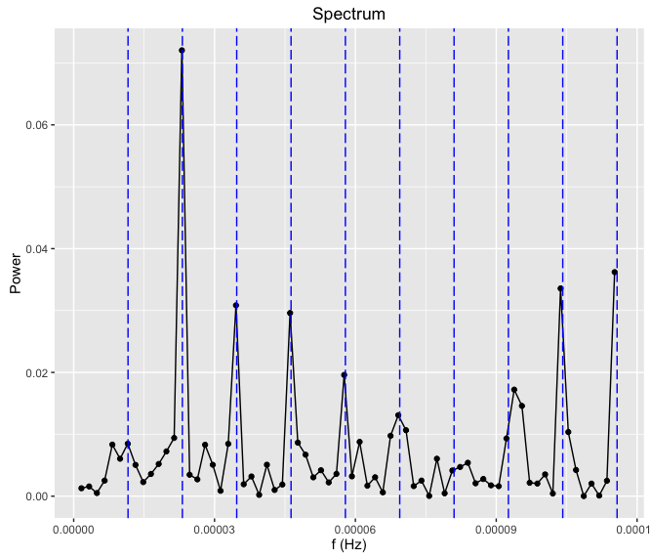
Discrete Fourier transform – Impact of noise

Slide 25
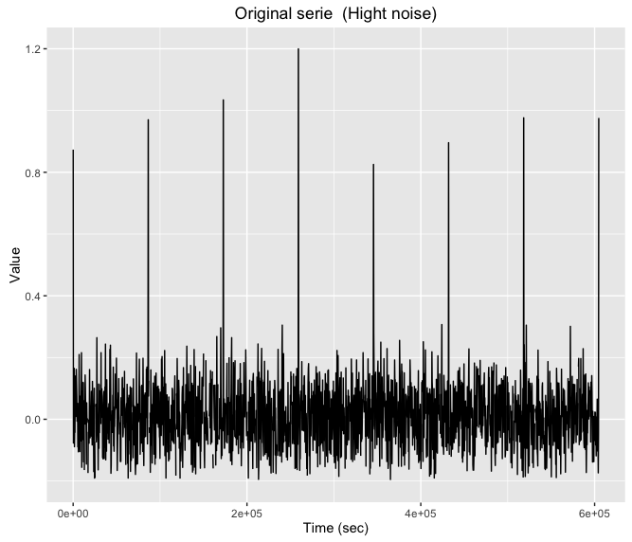
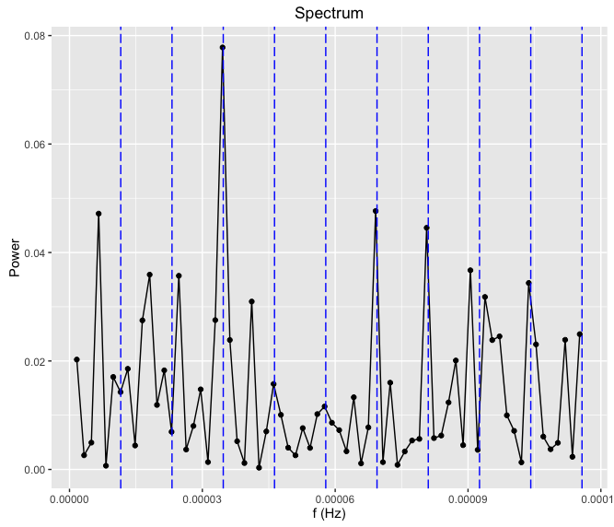
Discrete Fourier transform – Impact of noise

Slide 26
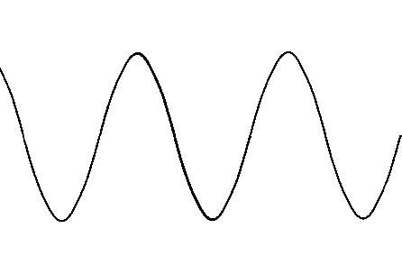
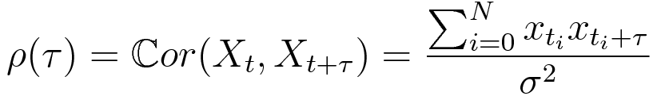
Autocorrelation - Definition
𝝉

Slide 27
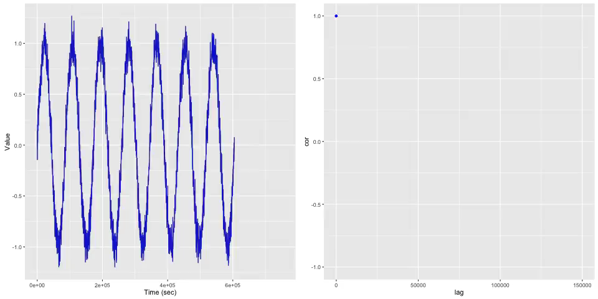
Autocorrelation - Definition

Slide 28
Autocorrelation – Algorithm
Algorithm outline:
Compute ACF of the time series
Find local maximums
Filter relevant maximum

Slide 29
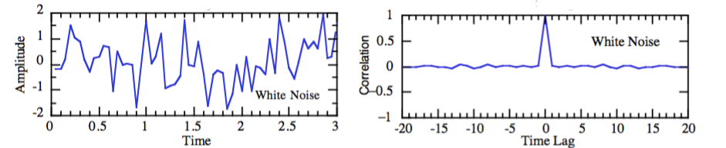
Autocorrelation – Theoretical advantages
ACF of noise is zero

Slide 30
Discrete Fourier transform vs. Autocorrelation
Discrete Fourier Transform | Autocorrelation
Fast O(N log(N)) | CPU intensive O(N²)
Linear so the spectrum contains noise and anomalies | Reject noise and anomalies
May catch the harmonic instead the main frequency: Problem | May catch the multiple of the period: Not a real problem
Very complicated to compute when there is missing sample | More robust to missing samples
Numerical pitfalls : Sampling, precision, aliasing, windowing…

Slide 31
TIME SERIES MODELING

Slide 32
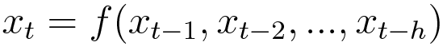
TIME SERIES MODEL & (S)ARIMA MODELS
F can be :
Linear : ARIMA models
Neural network (RNN, LSTM …)
All functions we can imagine

Slide 33
WHY ARIMA ?
(S)ARIMA is the best linear time series model, consequence of the Wold theorem
One model for season, trend, level and noise, no need to model each part separately.
But estimation of seasonal models is extremely slow

Slide 34
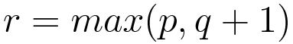
TIME SERIES MODEL & (S)AR(I)MA MODELS
Auto regressive part (AR)
Moving average part (MA)

Slide 35
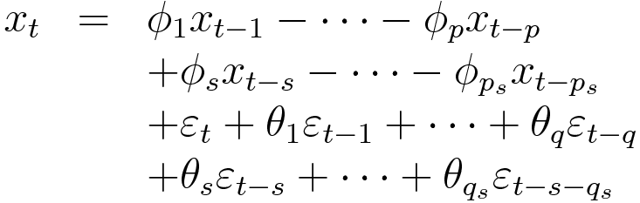
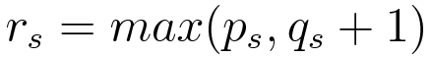
TIME SERIES MODEL & (S)ARIMA MODELS
Seasonal terms

Slide 36

ARIMA ESTIMATION – THE BIRD VIEW STRATEGY
Maximum likelihood estimation (MLE)
Likelihood
Maximum finding
Need to compute the gradient of the Kalman filter !
Newton algorithm

Slide 37
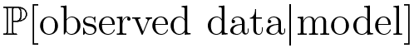
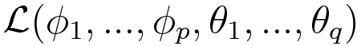
LIKELIHOOD
The maximum of the likelihood function is the best possible estimation of the parameters

Slide 38
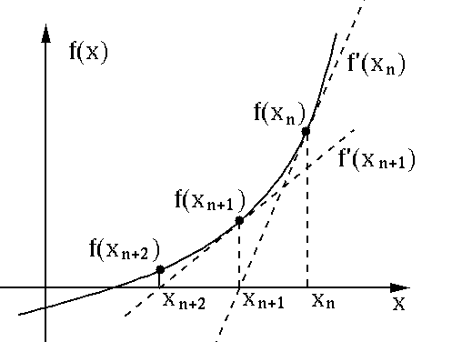
OPTIMIZATION
H can be :
Gradient => gradient descent
Hessian (Second order derivative of g) : Newton algorithm
Many other possibilities, Quasi-Newton algorithms: BFGS, SR1 …

Slide 39
EXERCISE
Open the 1d directory. Load and plot the data
Try to fit an arima for Real11
Make a forecast and plot it
Refine the model with Box-Jenkins method
Find the best model with auto.arima
Do the same with Real12
Try to estimate a seasonal arima for a weekly 5m time series

Slide 40



Thank you for you attention

Slide 41

THANK YOU

